Slide 1


Customer Shopping Behavior Analysis
End-to-End Data Analytics Project using Python, SQL & Power BI
PRESENTED BY
Sourav Mukherjee

Slide 2




Project Overview & Business Problem
Project Objective
Business Problem
The primary goal of this project is to perform a comprehensive analysis of 3,900 transactional records to uncover hidden spending patterns and customer preferences.
The business faces challenges in identifying the key drivers of revenue and understanding how subscriptions and discounts impact long-term customer loyalty.
Fragmented view of customer segments
By leveraging Python, SQL, and Power BI, we aim to bridge the gap between raw transactional data and actionable business intelligence.
Unclear ROI on discount strategies
Need for personalized marketing efforts
"Transforming 3,900 data points into a strategic roadmap for business growth and customer retention."

Slide 3




Tech Stack & Dataset Overview
Python
SQL (MySQL)
Power BI
Data Cleaning, Imputation, and Feature Engineering using Pandas & NumPy.
Complex Business Queries, Data Segmentation, and Revenue Analysis.
Interactive Visualization, KPI Tracking, and Dashboard Development.
Dataset Summary
3,900
18
37
100%
TOTAL ROWS
KEY COLUMNS
MISSING VALUES
DATA INTEGRITY
Key Features: Age, Gender, Location, Subscription Status, Item Purchased, Category, Purchase Amount, Frequency, and Review Ratings.

Slide 4





Data Cleaning & Feature Engineering (Python)
Missing Value Handling
Standardization
Identified 37 missing entries in the Review Rating column.
Normalized headers to snake_case for consistency.
Ensured compatibility with MySQL naming and cleaner code.
Applied category-median imputation to preserve distribution.
df.fillna(category_median)
Feature Engineering
Database Integration
Age Grouping: Binned ages into segments (Young Adult, Adult, Middle-aged, Senior).
Established secure connection to MySQL via SQLAlchemy.
Engagement:
Derived
purchase_frequency_days
.
Automated load of cleaned DataFrame into structured tables.

Slide 5




SQL Business Analysis
Revenue Analysis
Customer Segmentation
Comparative study of revenue across gender segments.
Classification into New, Returning, and Loyal segments.
Analysis of repeat buyer behavior patterns.
Revenue contribution by age group brackets.
Frequency of purchase vs. customer lifetime value.
Identification of high-value geographic locations.
Discount Impact
Subscription Analysis
High-spending users utilizing discounts vs. full-price.
Revenue comparison: Subscribers vs. Non-Subscribers.
Identification of discount-dependent product categories.
Impact of subscription status on purchase frequency.
Correlation between promo usage and order volume.
Likelihood of subscription for high-volume buyers.

Slide 6




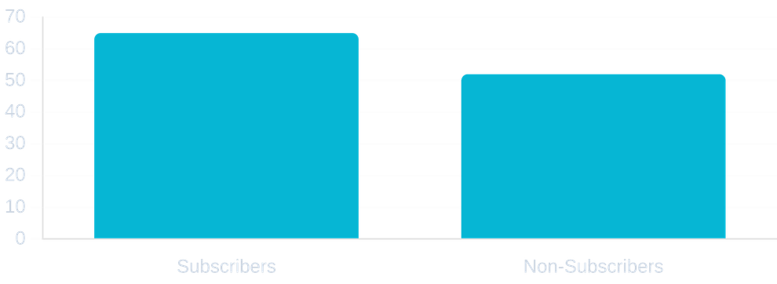


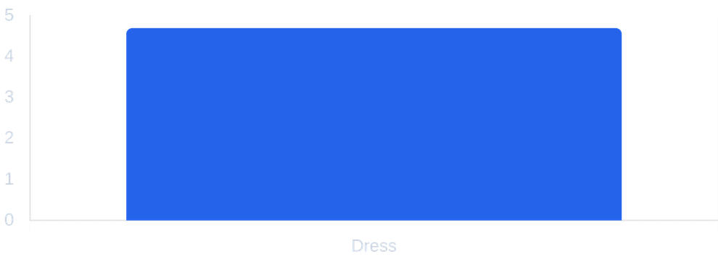
Key SQL Business Insights
Revenue by Gender
Subscribers vs. Non-Subscribers
Top 5 Products by Rating
Shipping Type Comparison
Product | Rating
Handbag | 4.9 ⭐
Shoes | 4.8 ⭐
Dress | 4.7 ⭐
Jewelry | 4.6 ⭐
Sunglasses | 4.5 ⭐
Express vs. Standard
Analysis shows that Express Shipping users have a higher average purchase amount, indicating a premium customer segment.

Slide 7

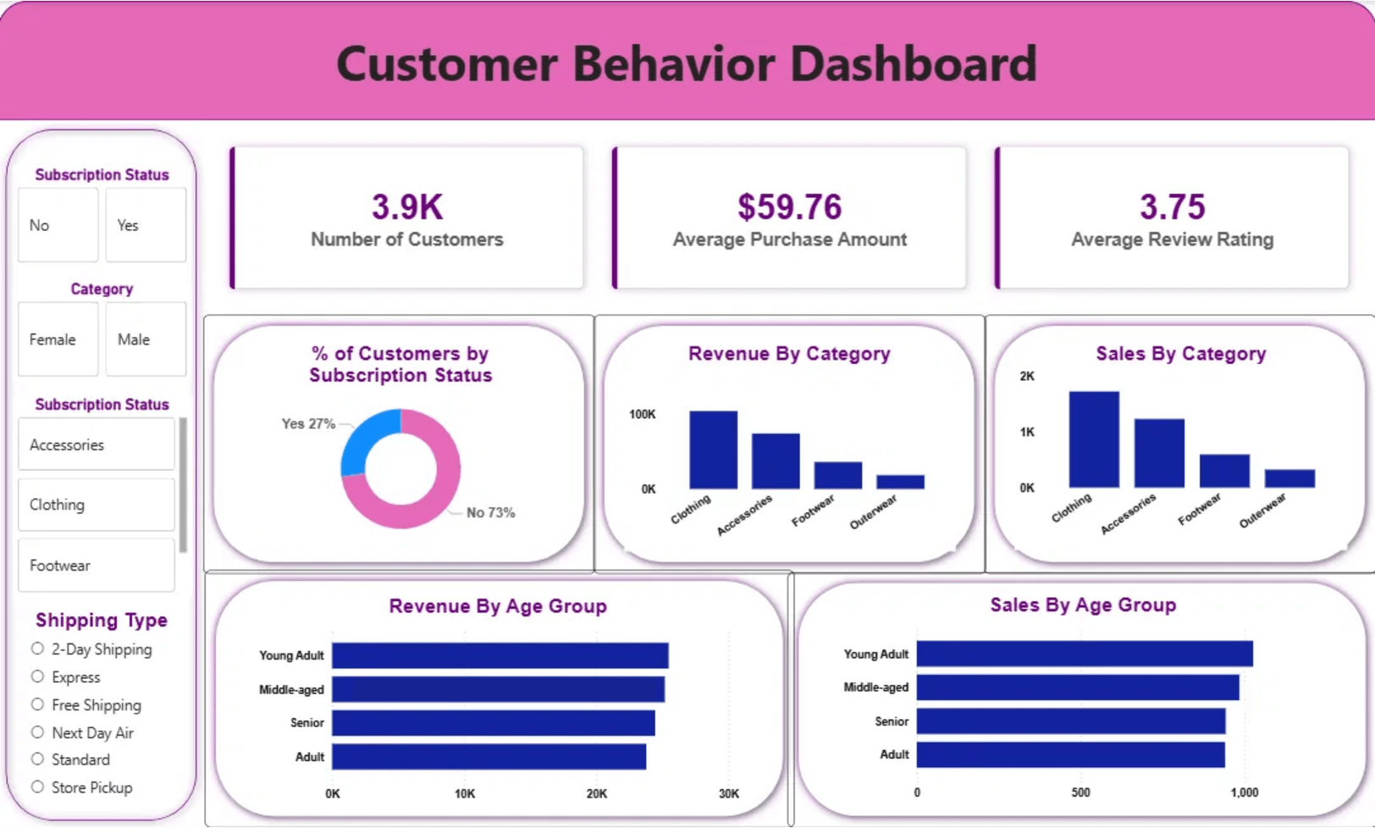




Interactive Power BI Dashboard
Real-time KPI Tracking
Dynamic Slicers & Filters
Customer Segmentation
Category Performance

Slide 8






Key Business Insights
Best-Performing Category
High-Revenue Demographics
Clothing and Accessories emerged as the top-performing categories, consistently delivering the highest ROI and customer satisfaction scores across all seasons.
The 25-45 age bracket represents the most profitable demographic, contributing over 45% of total platform revenue with a preference for premium items.
Highest Average Review Rating
45% Revenue Contribution
Subscription Impact
Shipping & Behavior
Subscribers demonstrate significantly higher engagement levels, with a 25% increase in average transaction value compared to non-subscribers.
Customers opting for Express Shipping show a strong correlation with higher purchase amounts, indicating a segment that prioritizes speed and convenience.
25% Higher Average Spend
High-Value Convenience Segment

Slide 9




Strategic Business Recommendations
01
Enhance Loyalty Programs
Implement tiered rewards for 'Returning' customers to incentivize the transition to the 'Loyal' segment.
02
Optimize Discount Strategy
Focus promotional efforts on 'Discount-Dependent' products to maximize volume without eroding overall margins.
03
Targeted Marketing Campaigns
Allocate marketing budget toward the high-revenue 25-45 age group and promote subscriptions to frequent buyers.
04
Strategic Product Positioning
Feature top-rated and high-ROI products in seasonal campaigns to drive conversion and customer satisfaction.

Slide 10







Thank You!
Successfully delivered an end-to-end analytics solution, transforming raw transactional data into a strategic roadmap for business growth and customer retention.
Data Wrangling
SQL Analysis
Data Visualization
Business Intelligence
linkedin.com/in/sourav-mukherjee
github.com/sourav-mukherjee

